Slide 1
WELCOME!

Slide 2




YOU ARE WELCOME!
WELCOME TO YOUR COMPANY
WELCOME TO FIBERONE BROADBAND LTD
WHAT CAN I SAY, YOU ARE WELCOME

Slide 3
TABLE OF CONTENTS
FOB – Vision, Mission & Values
HC Policies & Procedures
Who Are We?
What the Heart Contains
Our Ethos
Welcome 2 FOB
The DNA
How do we LOOK?
Org Structure
The Shape of our Heart.

Slide 4
opportunities

Slide 5



fa
Ethos
Fast:- Speed matters. We set clear direction and move fast. Learn quickly and share learnings. We focus on outcomes.
Bold:- Dream big – with innovative ideas. Make tough decisions quickly and proudly stand accountable for them. Resilient and fearless to beat the competition
Responsive:- We take deliberate actions to reduce ‘noise’ in whatever form or shape from both internal and external customers
Empathy:- We will be therapeutically attuned and passionate everything customer
Resourceful:- We will be effective and efficient. We will provide tools that will facilitate value creation practices.
Empowered:- we have to trust the skills, experience and knowledge of the workforce. Challenge each other. Once in agreement, we commit collectively and hold each other accountable to deliver
Fast
Empowered
Bold
Ethos
Resourceful
Responsive
Empathy
BRREEF!!!!!!!!!!!!

Slide 6
THE SHAPE OF OUR HEART
INTERNAL AUDIT, RISK & COMPLIANCE
TECHNOLOGY
02
CUSTOMER EXPERIENCE
03
01
FINANCE
OPERATIONS
04
05
CORPORATE SERVICES
06
ENTERPRISE SALES
INFO. TECHNOLOGY
COMMERCIAL
07

Slide 7
FTTH AREAS AND LOCATION
IKEJA
01
08
VI
KETU
02
09
LEKKI
AREAS AND LOCATIONS
GBAGADA
03
10
AGUNGI
AREPO
04
11
OLOGOLO
FESTAC
05
12
ILORIN
SURULERE/YABA
06
13
ABUJA
PORT HARCOURT
ONIRU
07
14

Slide 8
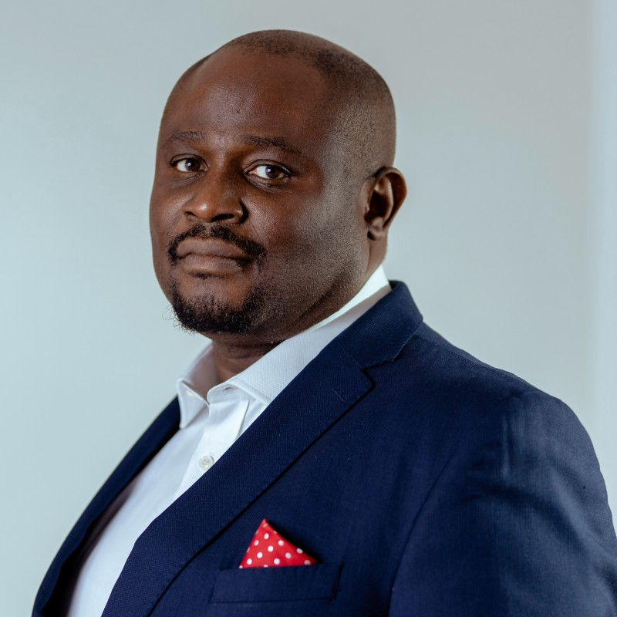


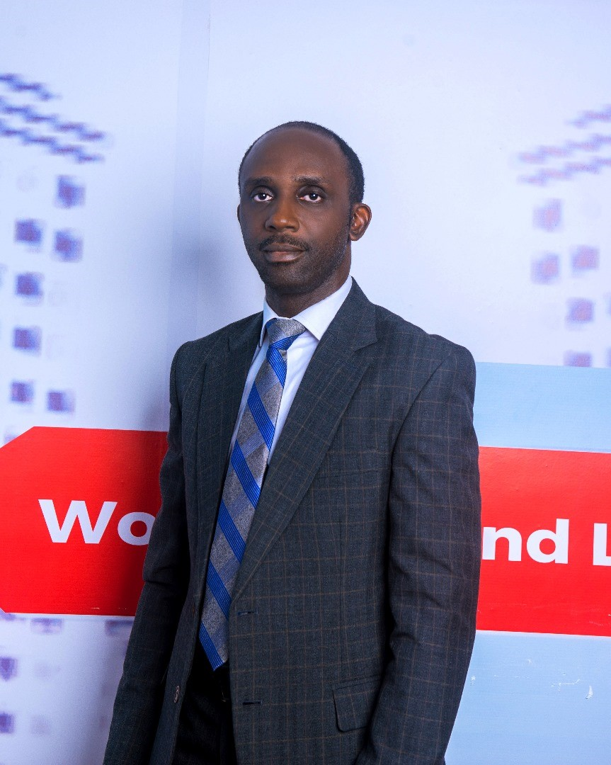

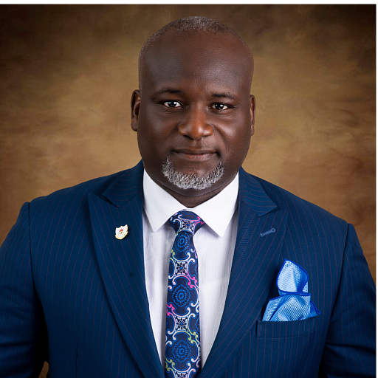


CORPORATE ORGANOGRAM
CEO
Chief Technical Officer
Chief Financial Officer
Head, Internal Audit, Risk & Compliance
Head, Operations
Chief Commercial Officer
Chief Experience Officer
Head, Corporate Services

Slide 9
Redefining FiberOne
Working Ecosystem -
People, Process &
Performance for
Balanced Growth

Slide 10
Regional Operations Model Agenda (ROMA) 2024 Plan
Corporate Services Department is pleased to present this ROMA 2024 Plan, outlining our vision, mission, values, ethos, GP, and focus areas, for the year 2024. As we navigate an ever-evolving business landscape, this agenda serves as a roadmap to guide the regional operations in delivering the organization’s objectives and KPIs for balanced growth and long-term success.
The ROMA 2024 seeks to build on the successes gained and the knowledge garnered in the past few years which has allowed for baselines to be established for several of our operational activities.
These baselines have allowed the Management Team to identify and acknowledge operational weaknesses and determine how best to treat and actualize opportunities where possible. In the last few years, we have sought to rework the operations as a means of delivering both the top line and bottom line of FiberOne and will now seek to compliment this push with greater focus on its PEOPLE, PROCESS (internal operating procedures and practices) and PERFORMANCE enabling greater resilience to change, agile workforce, high performance culture, process efficiency, motivated employees and a balanced growth (i.e., growth that is profitable, sustainable, and capital efficient).

Slide 11
Regional Org. Structure
CCO/CTO/CXO
Regional Manager -1
Regional Manager -2
Regional Manager UC
Manager, SD
Manager, CRM/Retention
Area Sales Manager/Regional Coordinator/CRM Regional Lead (Mainland)
Area Sales Manager/Regional Coordinator/CRM Regional Lead (Upcountry)
Area Coordinators/Cluster Sales Executives
Area Sales Manager/Regional Coordinator/CRM Regional Lead (Island)
Area Coordinators/Cluster Sales Executives
Area Coordinators/Cluster Sales Executives

Slide 12

Ice-Breaker
What is your impression of the word BLACK?

Slide 13



Salary, 13th Month and Performance Bonus
Staff salaries are paid between 25th – 30th/31st of each calendar month.
Year-end bonus and Performance Bonus are disbursed at the discretion of the Board of Directors and Chief Executive Officer(CEO) and is paid to confirmed employees only.

Slide 14

Employee Confirmation
During the mandatory 6-months probationary period, employees’ are assessed on several factors including but not limited to performance on the job. Successful employee are thereafter confirmed subject to the outcome of the period.
Upon confirmation, an employee is entitled to the following benefits;
Internet Facility for your home
Welfare Loan
13th Month and Performance Bonus

Slide 15

Leave Benefit
Employees are entitled to the following leave days depending on contract type and nature of leave:
Full Time staff: 20 working days per annum(following confirmation of appointment)
Contract staff: 10 working days per annum ( after working for at least 6 months)
Casual Leave: 4 working days per annum
Compassionate Leave: 15 calendar days per annum
Maternity Leave: 12 weeks per annum (documentation is required)
Paternity Leave: 3 working days per annum (documentation is required)
Examination Leave: 7 working days per annum (documentation is required)
Sick Leave: 12 working days per annum (documentation is required, consult your health provider)

Slide 16

Leave Application
Employee Leave application must be approved by their Line Manager and HOD before coming to Human Capital.
Human Capital unit MUST approve leave request before an employee can proceed on leave.
Employee’s annual leave request will be approved based on the number of leave days earned at the time of application (minimum of 2days monthly)
Employee’s ability to provide requisite documentation validates the leave request in any of the categories (excluding Annual & Casual leave)
Only five (5) days of earned leave days can be carried over to the first quarter of the following year
Management reserves the right to approve or reject any leave application based on business need.

Slide 17

Medical Insurance (HMO)
We believe that the health and well-being of our employees and their families are of paramount importance
Employees(FTE) can add their dependents (spouse and four (4) biological children) to the plan.
Contract staff can access HMO services but are not eligible to add dependents.
For further details, information on the process, and a list of accredited healthcare facilities, please reach out to the Human Capital department at hc@fob.ng.

Slide 18

Staff Home Internet Facility
All active and confirmed Full-Time Employees are eligible to request for staff home internet.
All staff home internet allocated service plan shall be subject to a period of renewal every 6 months from the activation/confirmation date by sending a renewal request to Head of Information Technology two week before expiration requesting for a renewal.
Any hardware or software purchased by the company regarding the internet provisioning remains the property of the company and must be returned to the company upon termination of contract or resignation.
Please reach out to the IT team on InfoSystem@fob.ng for guidance on the Staff Home Internet (SHI) facility and how to access it.

Slide 19


OUR CULTURE

Slide 20


Identification (ID) Card Policy
All employees must always wear their identification cards visibly while in company premises. Without the proper display of identification cards, employees will not be granted access to the company facilities.
Non-compliance to this policy will not be taken lightly, and sanctions may be applied to anyone found guilty of not wearing their ID cards.

Slide 21
Acceptable Email Etiquette
Email Etiquette Rules You Should Know
Have a Subject
Open with a Greeting, e.g. 'Dear first name' or 'Hi,' Hello, Good morning, etc.,
Explain the Subject of discussion and make the Purpose crystal.
Use the approved Color and Font. (Avenir Next LT Pro, size 12 & colours: Blue Accent 1, 25 darker)
Don’t use capital letters. It appears you are yelling e.g., ADHERENCE TO OFFICIAL RESUMPTION AND CLOSING TIME
Use Initial Cap instead, e.g., Adherence to Official Resumption and Closing Time.
6.Use colored text to highlight your responses if need be
7.Know when to use CC /BCC/Reply All.
8.For Attachments (Password Confidential Document
NB; You can only send 15mb for outgoing and incoming mail, Zip and compress large files, describe the zipped attachment for easy reading
confidential

Slide 22
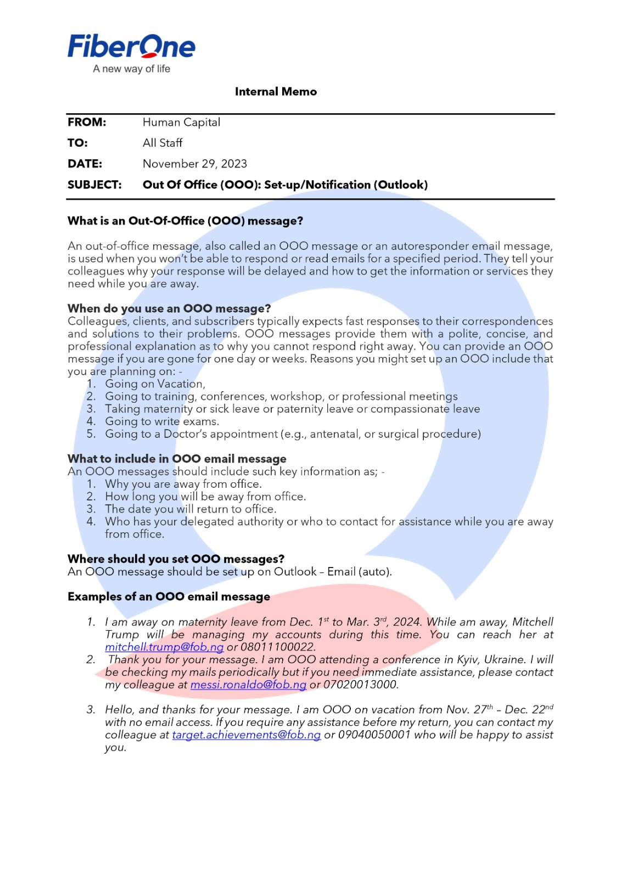

Slide 23
Employee Loan Application
This benefit is designed to offer short –term loans at low interest rates to assist in meeting urgent financial obligations.
Eligible employees can access up to 15% of their gross pay with a repayment period of 6 months @ 5% interest.
Lease financing of mobile phones, laptops and home appliances is also available. However, the repayment period for this is 3 months. Also,
      Any device/home appliance less than 50,000 attracts no interest
      Any device above 50,000 but less than 100,000 will attract 1% interest
      Any device above 100,000 will attract 2% interest
      Employees can also purchase energy solutions from our sister company (Icellpower) on this scheme.
      Please note that this benefit is exclusively available to confirmed employees who meet the eligibility criteria.
      If you have any questions or need further information about the employee welfare loan, please feel free to reach out to the welfare team by sending an email to staffwelfare@kkontech.com

Slide 24
Standard of Business Conduct (SoBC)
Standard of Business Conduct policy (click here to access the document)
Standard of Business Conduct declaration form (click the link to sign of https://forms.office.com/r/YAnckuZPGV)
Should you have any questions, please reach out to your Line Manager, Legal Team, BPSQ, or HC team.
You are required to fill the declaration form on the first day of your onboarding

Slide 25

Whistleblower Policy
The company encourages employees and other relevant stakeholders to report perceived unethical or illegal conduct of employees, management, directors and other stakeholders in the appropriate authority in a confidential manner without any fear of harassment, intimidation or victimization.
Use any of the following media to whistle blow
•Formal letter to the Chief Executive Officer or the Head, Internal Audit, Risk and Compliance (HIARC)
•Dedicated phone number: [+2347031024819]
•Dedicated email address: [speakup@fob.ng]
If you have any concern, forward it to Head, Internal Audit, Risk and Compliance with a copy to the Chief Executive Officer and it will be investigated.
If the concern affects the HIARC, notify the Chief Executive Officer
YOU HAVE A ROLE TO PLAY!!

Slide 26
Official Resumption and Closing Time
Punctuality is a core value that reflects our commitment to professionalism, discipline, and respect for our colleagues and the organization.
Arriving at work on time and leaving at the designated closing time is crucial for maintaining a productive and harmonious workplace
Adhering to official times ensures that our daily operations run smoothly and consistently.
For those of us who interact directly with clients or customers, adhering to our opening and closing times is critical for providing high-quality service.
While we understand that emergencies and special circumstances can arise, repeated violations of our resumption and closing times will not be tolerated.
Failure to comply with working hours and schedules without proper authorization may lead to disciplinary consequences.

Slide 27
Clean Desk Policy
Hygiene: Eating on the work desk can result in having crumbs and spills that can impact the lifespan of the systems. Food odor can attract pest and create an unsafe work environment.
Cleanliness: Food particles can find their way into systems keyboard and other accessories which can affect their performance and longevity.
Respect: Eating on your desk can be distracting for other colleagues especially when they are trying to focus on their task or participate in virtual meetings.
Break: Taking short breaks away from your desk can help stretch your muscles as a sedentary worker and keep you reenergized which in turn improves morale and productivity.

Slide 28
DRESS CODE POLICY
All Employees’ are to adhere to the Dress Code Policy of the organization.
Wearing of native attire during work hours on the premises is prohibited
The dress code policy remains in effect until otherwise advised and as such compliance is required from All and sundry.
It is important to maintain a consistent professional appearance in the workplace.
Non-adherence to the stipulated dress code policy is frowned at and may result in appropriate disciplinary measure.
Corporate casual is highly encouraged

Slide 29

Staff Exit Policy
During probation, either the company or the employee, in the event of termination; voluntary or otherwise, shall give two (2) weeks’ notice in writing OR payment of two (2) weeks gross salary in lieu of notice.
Upon confirmation of appointment, either the company or the employee, in the event of termination; voluntary or otherwise, shall give one (1) month notice in writing OR payment of one (1) month gross salary in lieu of notice.
Employees are to submit their resignation to their Line Managers in line with the required notice period and copy Human Capital.
This commences the exit process.

Slide 30
FIBERONE IMPACT DOMAINS
LEADERSHIP
CULTURE
PEOPLE
RESULTS
Authenticity
First Name
Empowered
Work-Life-Balance
Coaching
Camaraderie
Diversity
Built To Last
Transcendence
Institution
Engagement
Profitability

Slide 31


